Slide 1
The Global Spread of Arbitrary Immigration Detention
By Michael Flynn
MSF-Italy:
General Assembly
Rome 11 April 2026

Slide 2
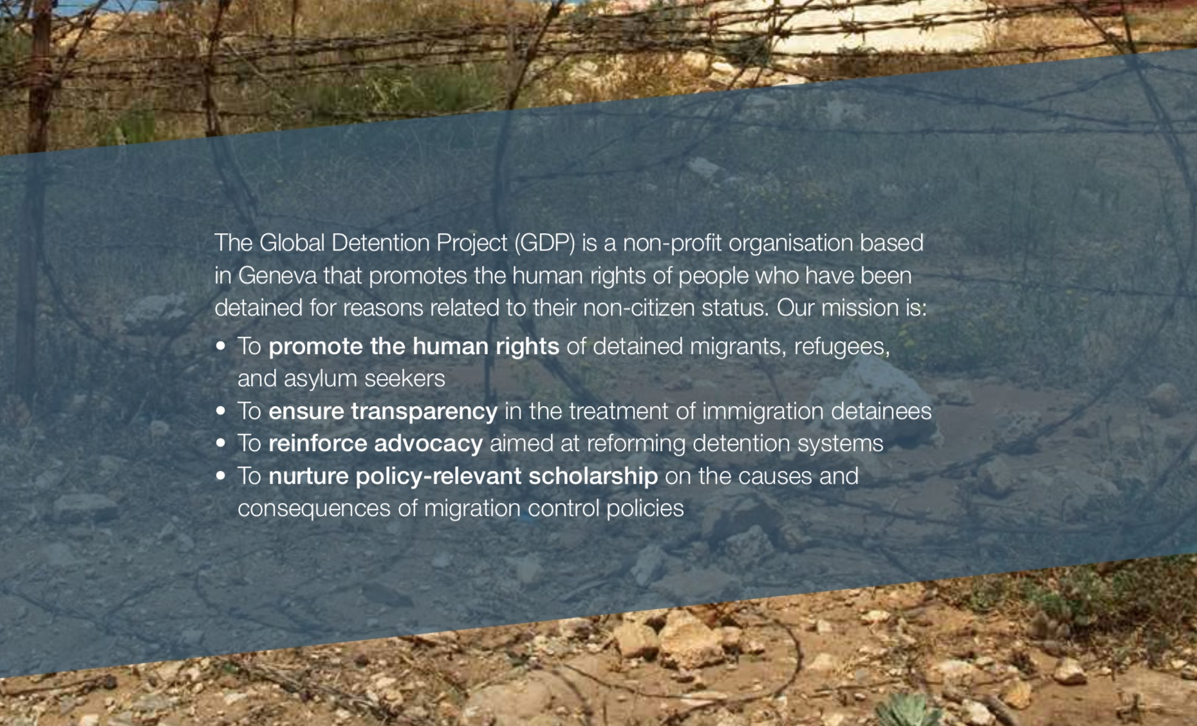
SLIDE 1: GDP Mission
globaldetentionproject.org

Slide 3
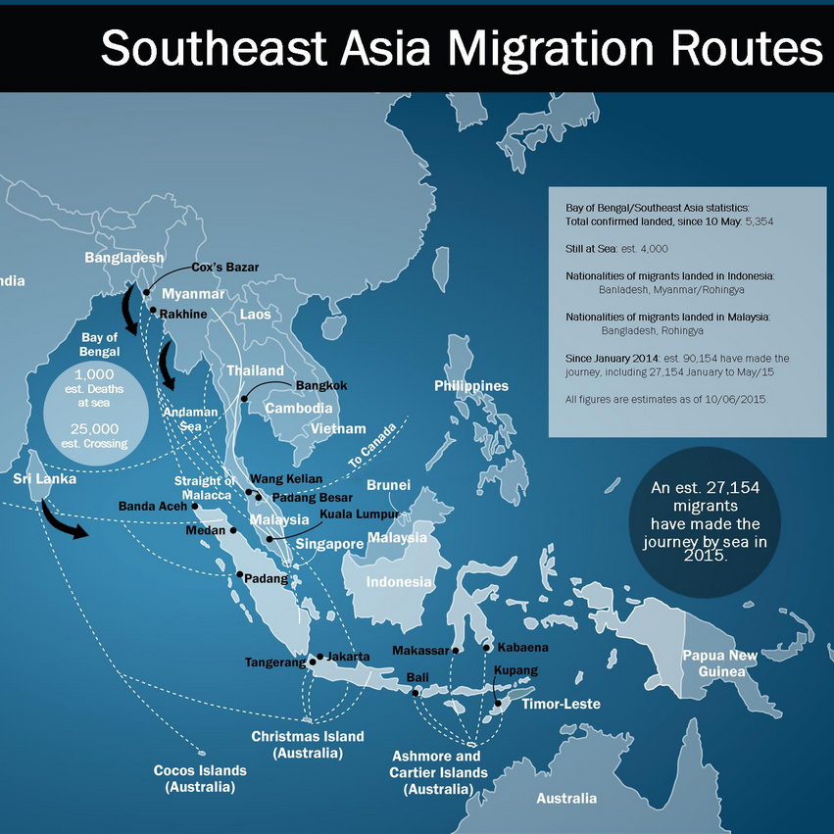
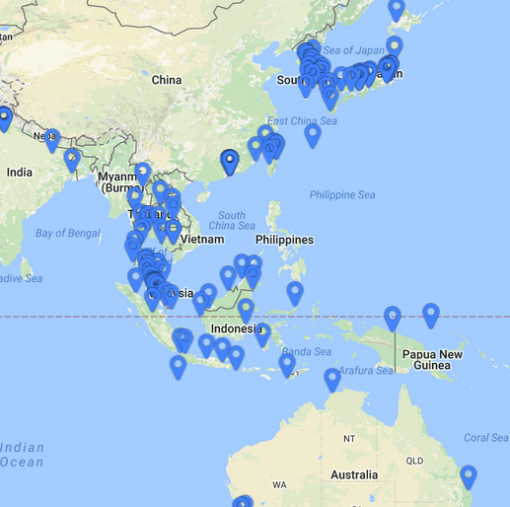
SLIDE 2: Mapping detention on migration routes
globaldetentionproject.org

Slide 4
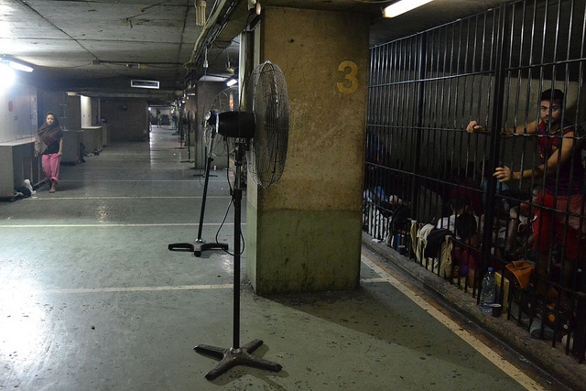
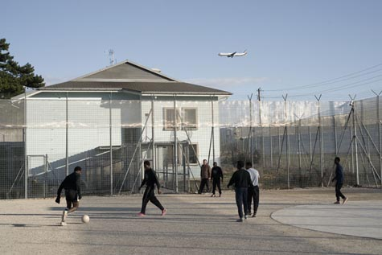
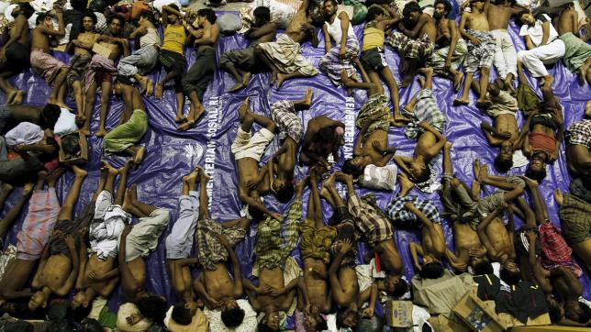
SIDE 3: Detention Centers around the World
globaldetentionproject.org
Notes:
Clockwise: Adlieh Detention Centre, Beirut; Hutto “Residential Centre,” Texas; Aceh Detention Centre, Indonesia; Frambois Detention Centre, Geneva, Switzerland.

Slide 5
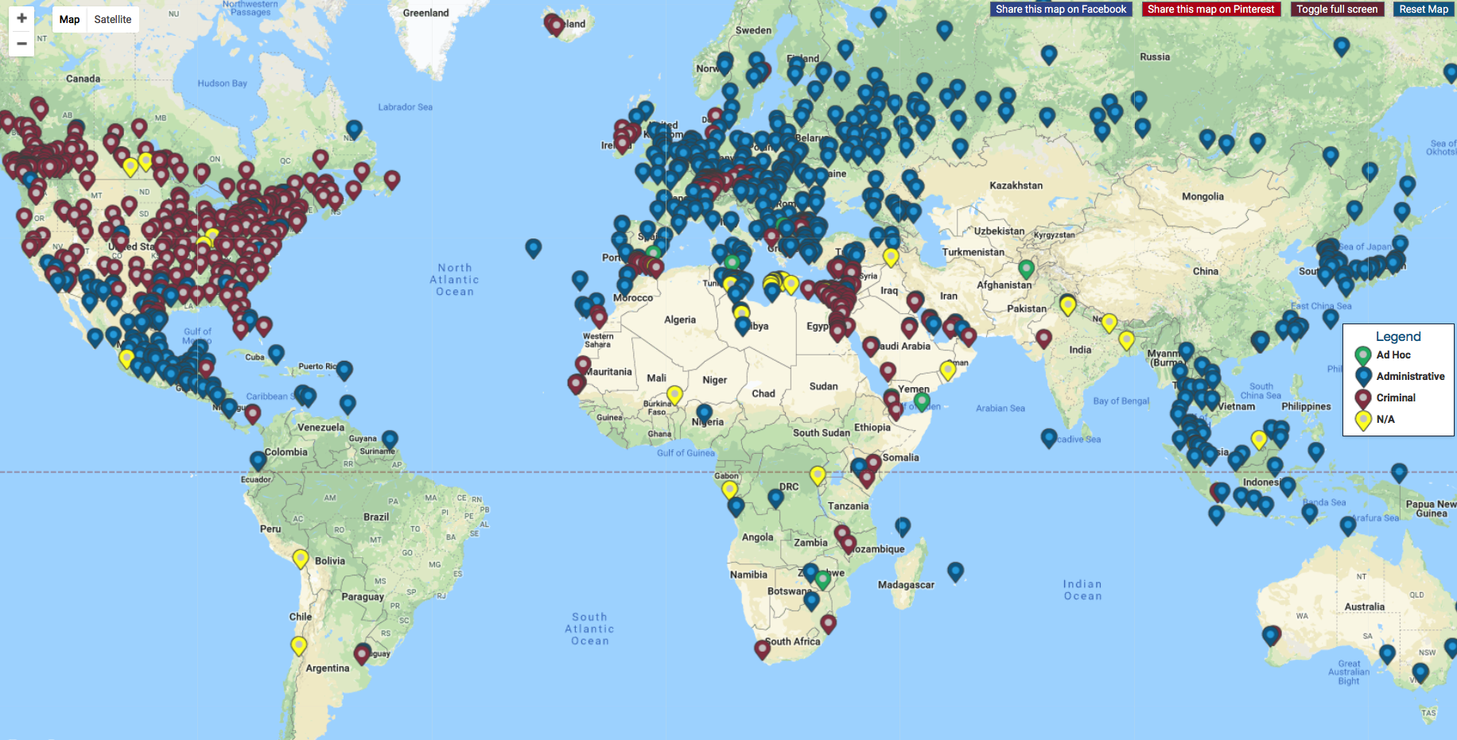
SLIDE 4: GDP Map of Detention Sites
globaldetentionproject.org

Slide 6
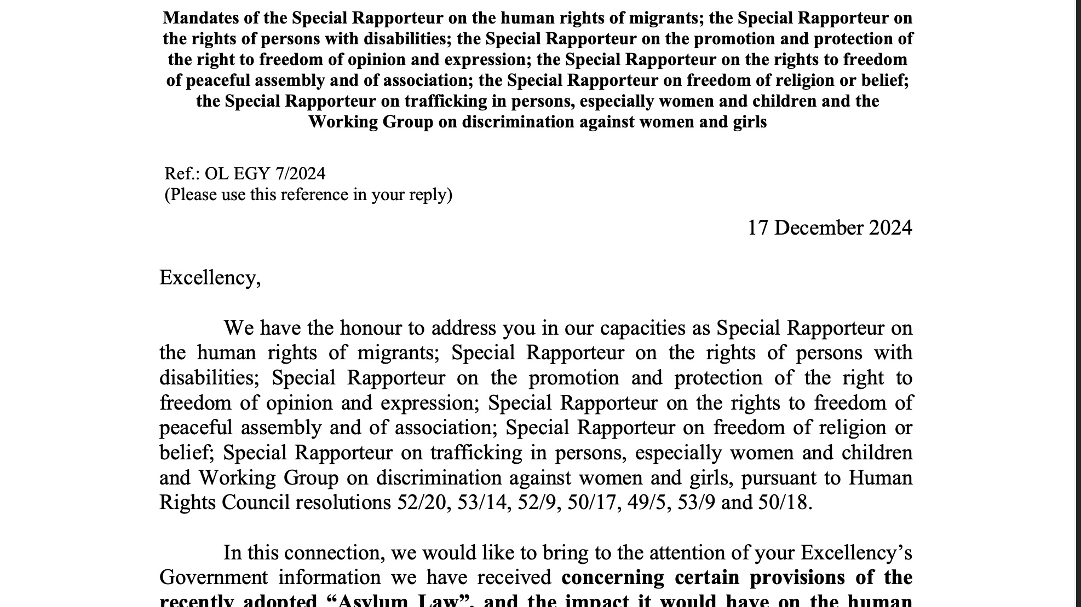
SLIDE 5: UN Special Procedures Appeal to Egypt 2024
globaldetentionproject.org

Slide 7
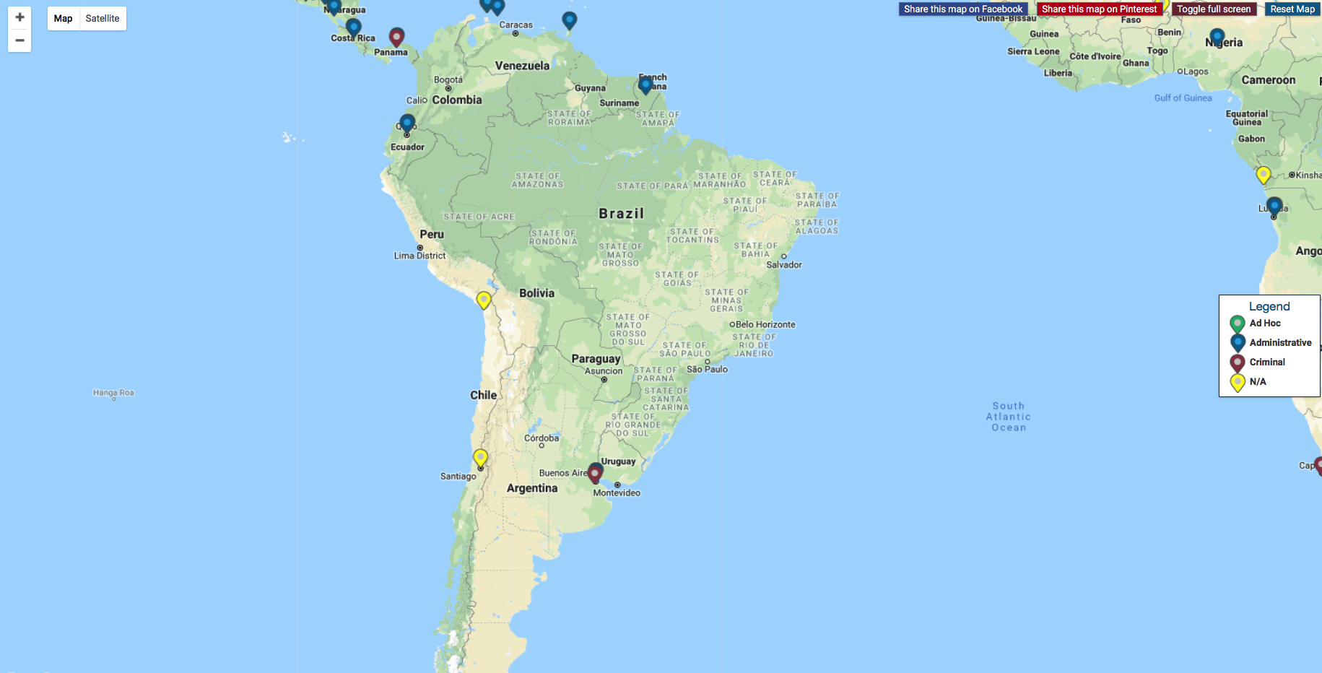
SLIDE 6: Detention centres in South America
globaldetentionproject.org

Slide 8
SLIDE 7: EXTERNAL CONTEXT OF SPREAD OF DETENTION
Increasing scapegoating of migrants and refugees for societal problems.
The emergence of populist political regimes that eschew a rules-based international order.
Growing financial crises across the UN system.
Diminishing global support for regional and international human rights mechanisms.
globaldetentionproject.org

Slide 9
SLIDE 8: THREE INHERENT ASPECTS OF IMMIGRATION
I. People in immigration detention typically are not charged with crimes and thus are not afforded the full protection of the law.
II. Immigration detainees are not supposed to return to the societies where they are detained.
III. Countries often hide or disguise their immigration detention practices.
globaldetentionproject.org

Slide 10
SLIDE 9: PATH FORWARD
Any initiative that seeks to prevent the spread of harmful immigration detention practices must:
Ensure that harmful practices get local and global attention
Develop evidence that can be used to mobilize protections that extend beyond local jurisdictions, focusing on universal human rights norms
Empower those who have lived through it—or who are most vulnerable to it—to document it, report it, and be the leading voices for change.
globaldetentionproject.org

Slide 11
Global Detention Project
Geneva, Switzerland
+41 (0) 22 548 14 01 admin@globaldetentionproject.org
globaldetentionproject.org

